Slide 1
National Central University
Install Raspbian on Raspberry Pi 3 model B+
Network Computing Laboratory, CSEE, NCU

Slide 2

Outline
Introduction
Build up system
Enable UART serial
Configure network
Connect to Pi (SSH)
Copy files to Pi (SCP, FileZilla)
2

Slide 3
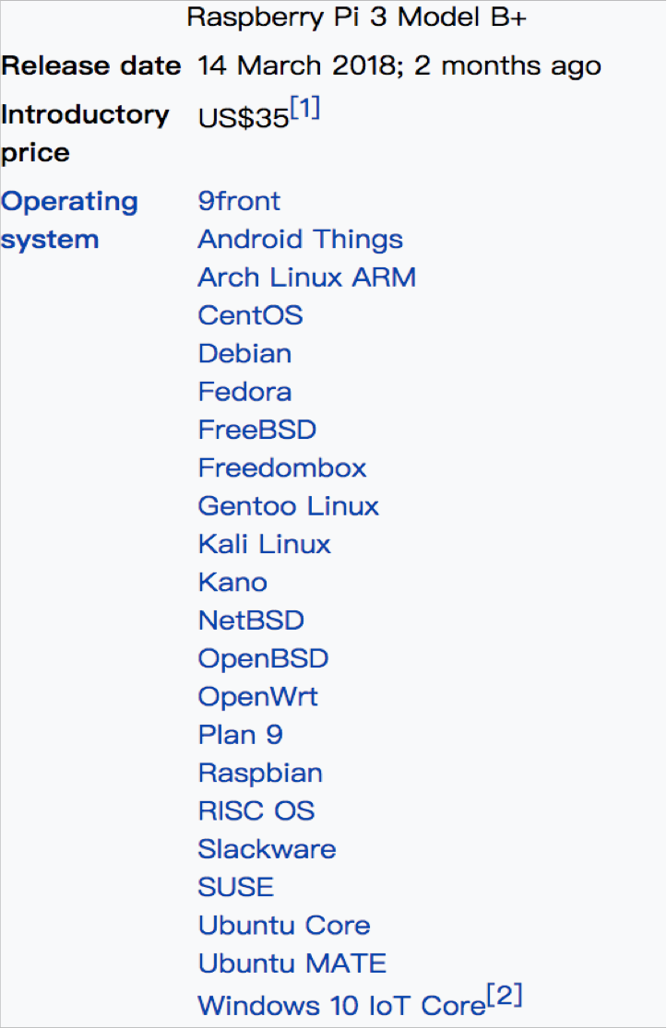
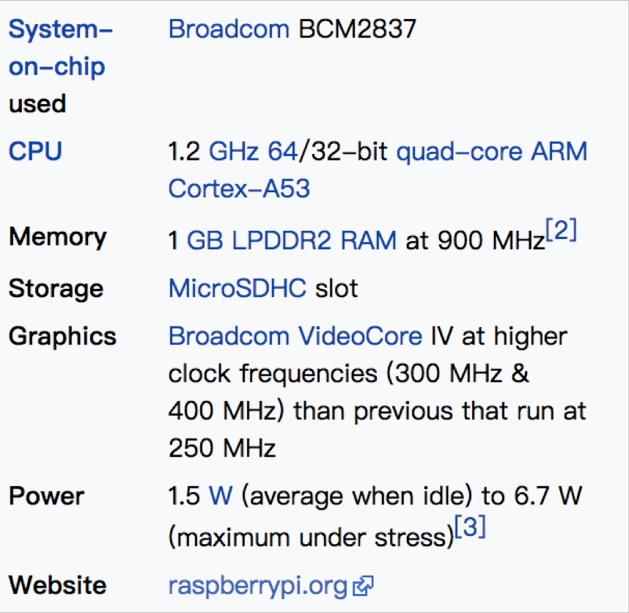
Introduction
Raspberry Pi 3 model B
From https://en.wikipedia.org/wiki/Raspberry_Pi
3

Slide 4


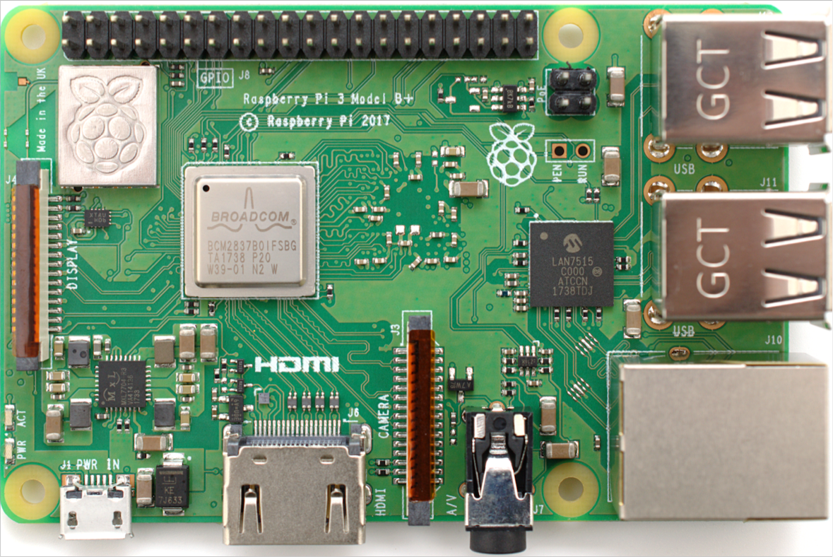







Introduction
Raspberry Pi 3 model B
Power-over-Ethernet
40 GPIO Pins
Micro SD cad slot (on the back of Pi)
USB Port * 4
Ethernet
micro USB power supply (2A, 5V)
HDMI
Camera interface (CSI)

Slide 5
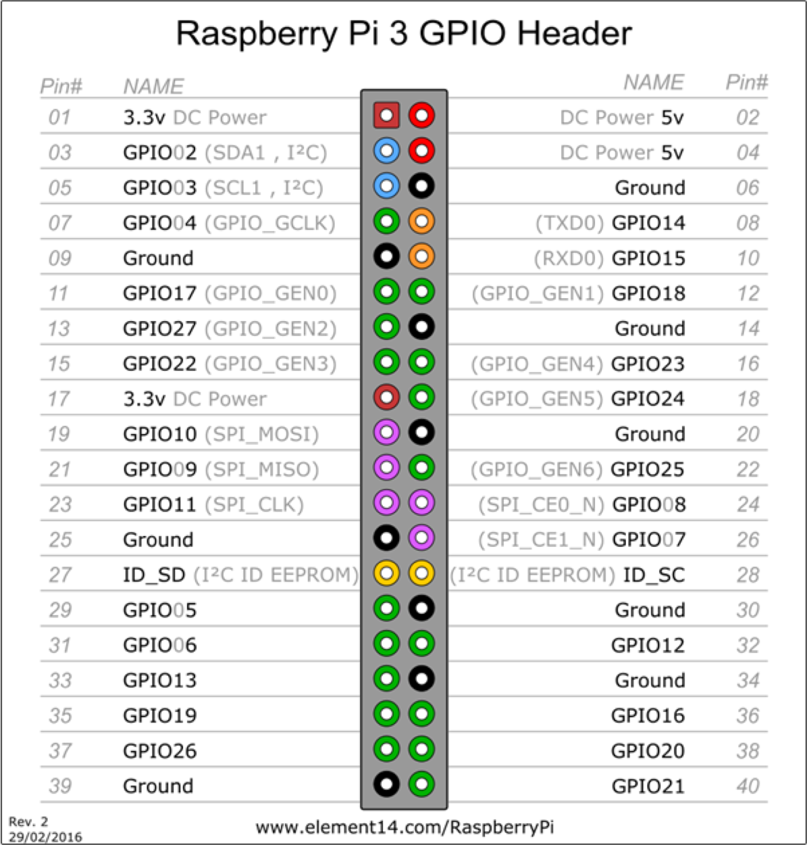
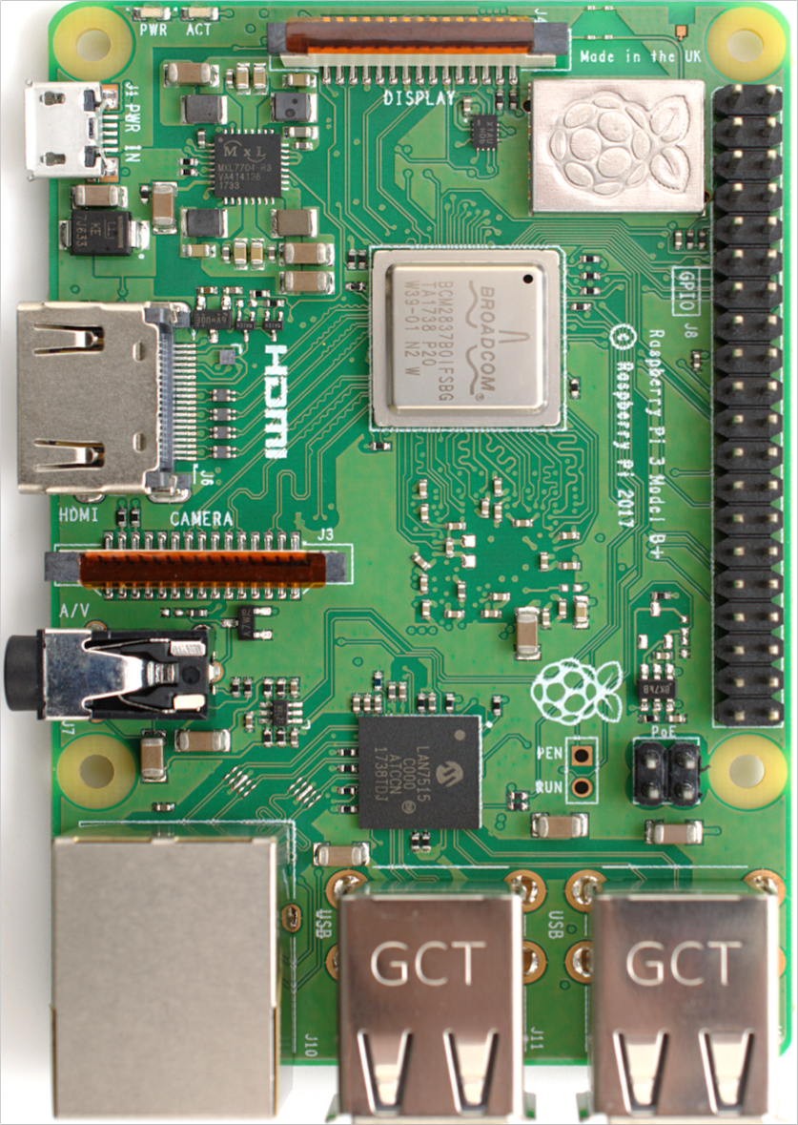
Introduction
General-purpose input/output (GPIO)
Note that the physical PIN number is different from the GPIO number.

Slide 6
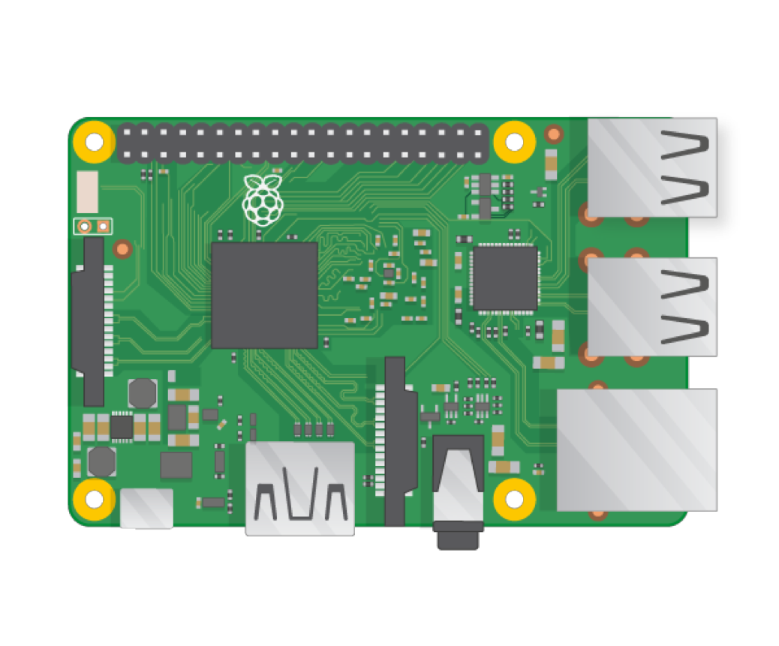


Build up a system
Now, let we set up our Raspberry Pi system.
First, we need to download a Raspberry Pi operating system image file.
Then, we need to write that image to a SD card.

Slide 7
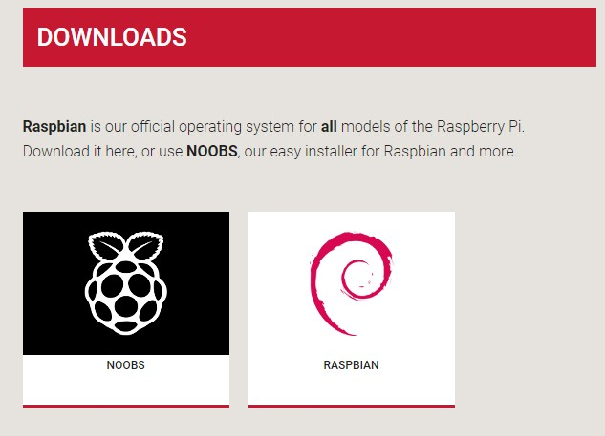
Build up a system
Download OS
Download
https://www.raspberrypi.org/downloads/

Slide 8
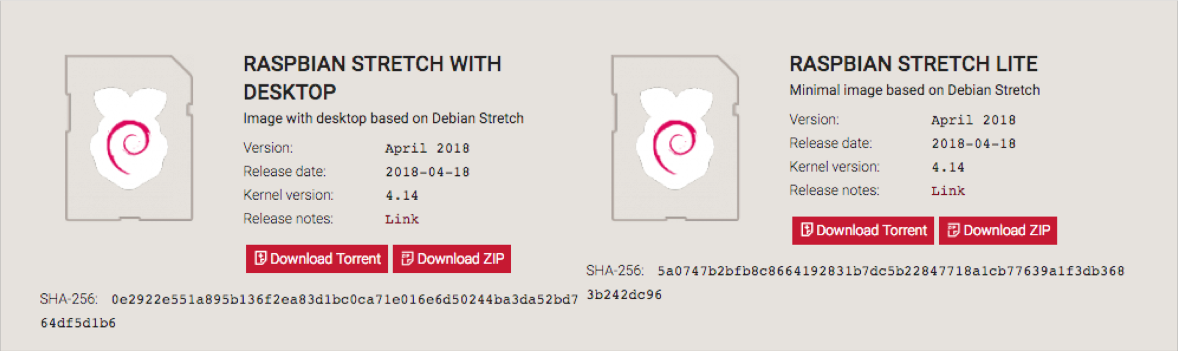

Build up a system
Download OS

Slide 9
Build up a system
Writing an image to the SD card
1. Formatting SD card. (SD formatter)
https://www.sdcard.org/downloads/index.html
2. Writing an image to the SD card. (Etcher)
https://etcher.io/

Slide 10


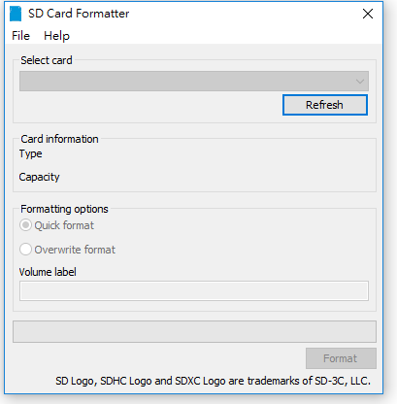
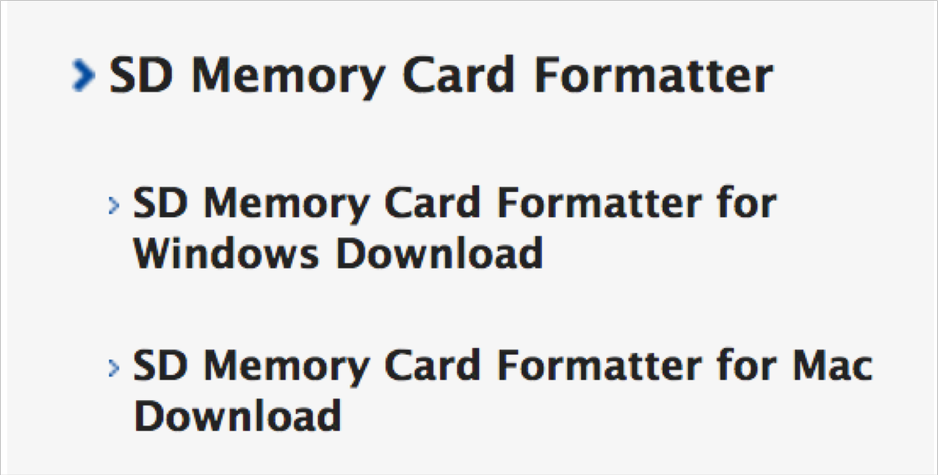

Build up a system
Formatting SD card
Step1. Choose OS
Step2. Select your SD card
https://www.sdcard.org/downloads/index. html
Step3. Format the SD card
10

Slide 11
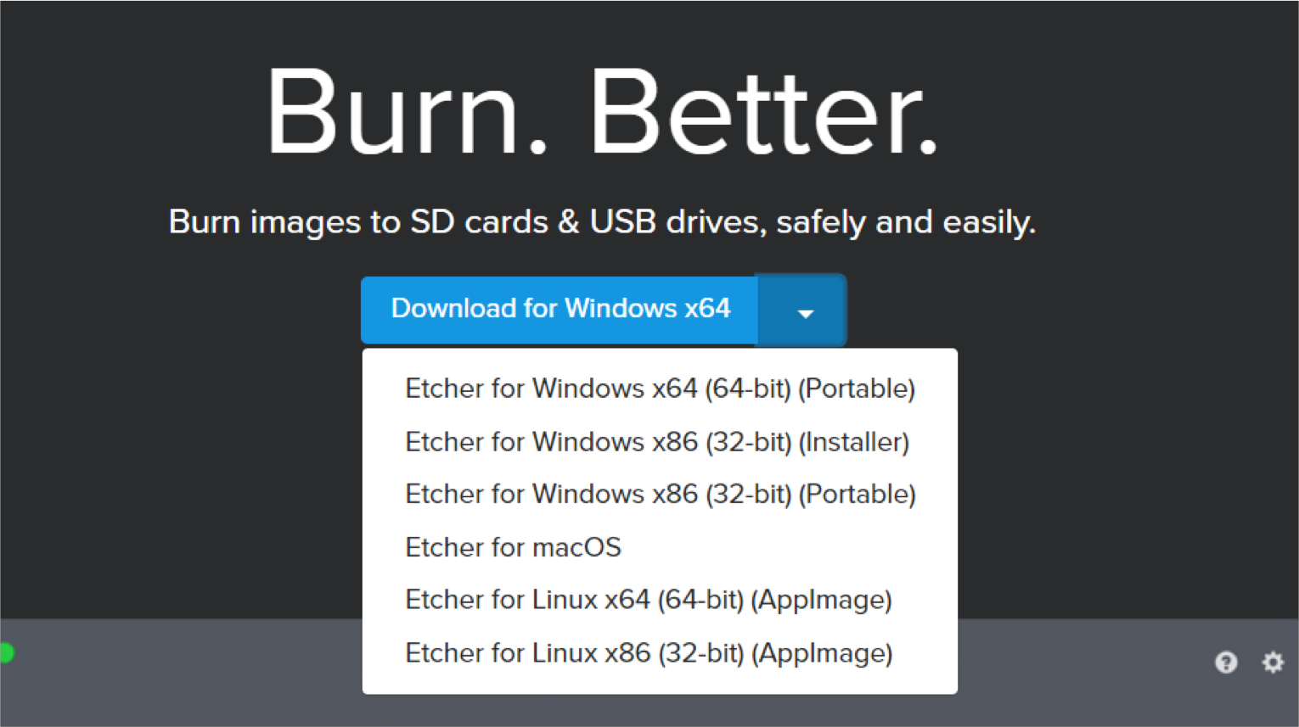
Build up a system
Writing an image to a SD card
To write an image to a SD card, the easy way is using Etcher which works on Mac OS, Linux and Windows. (May take long time to write the image)
Visit etcher.io and download and install it.
https://etcher.io/
11

Slide 12
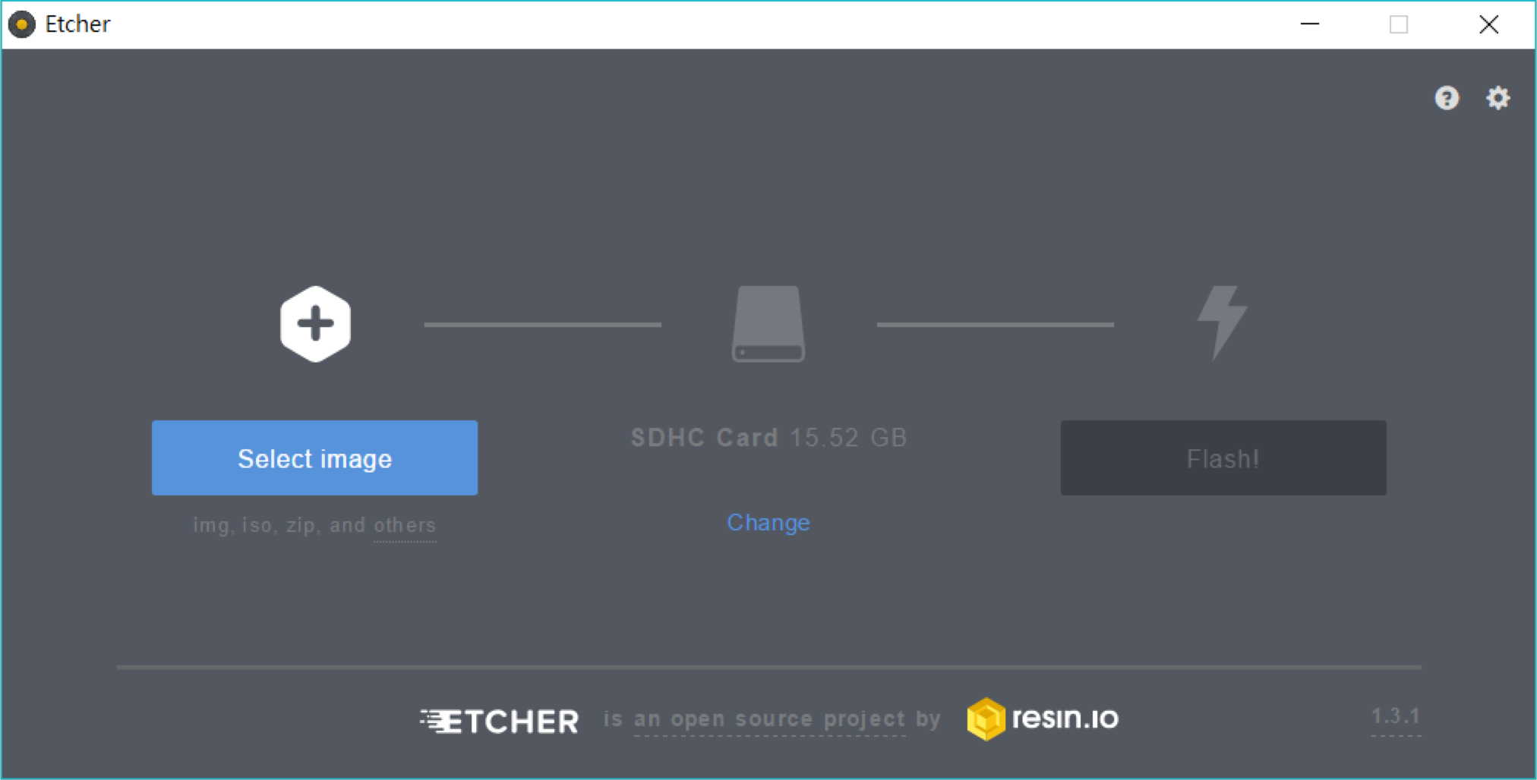
Build up a system
Writing an image to a SD card
Open Etcher and follow these 3 steps
1
2
3

Slide 13
What's next ?
As we eject the SD card after Raspbian has been installed in it, we should consider how to operate Pi as Pi might not connect to Internet.
Have a monitor with HDMI cable, a USB keyboard and mouse.
No
Use UART to connect (TTL serial)
SSH connection with
Internet (IP needed)
VNC connection with Internet (IP needed)
Yes
Operate Pi directly and have fun.

Slide 14

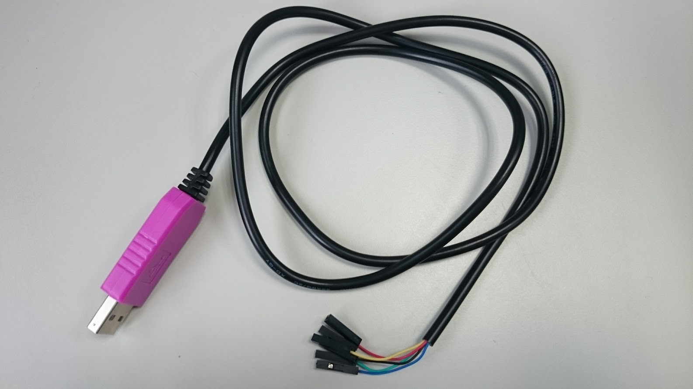

Enable UART
At the first time, your Raspberry pi has no Internet connectivity and doesn't enable SSH.
So, we have to turn on the UART port (TTL serial) to connect our Pi and then configure network settings and enable SSH.
PL2303HXD USB to TTL
We will use this PL2303HXD cable in this tutorial.

Slide 15
Before the next step
As we need to modify some files in the SD card, we recommend to use Notepad++ or other editor to modify files because the default Notepad of Windows might have encoding issues with that file.
Notepad++
https://notepad-plus-plus.org/
Don't forget to inject your SD card into your computer again.

Slide 16
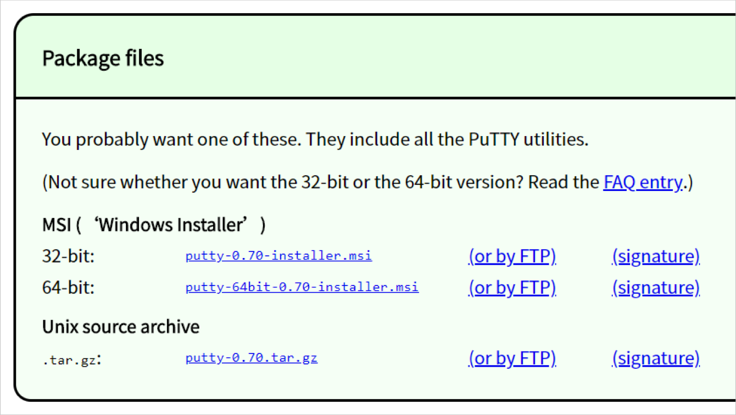
Before the next step
If you are using Windows, you will need Putty to connect your Pi by UART/TTL serial.
Download and install Putty.
https://www.chiark.greenend.org.uk/~sgtatham/putty/latest.html

Slide 17
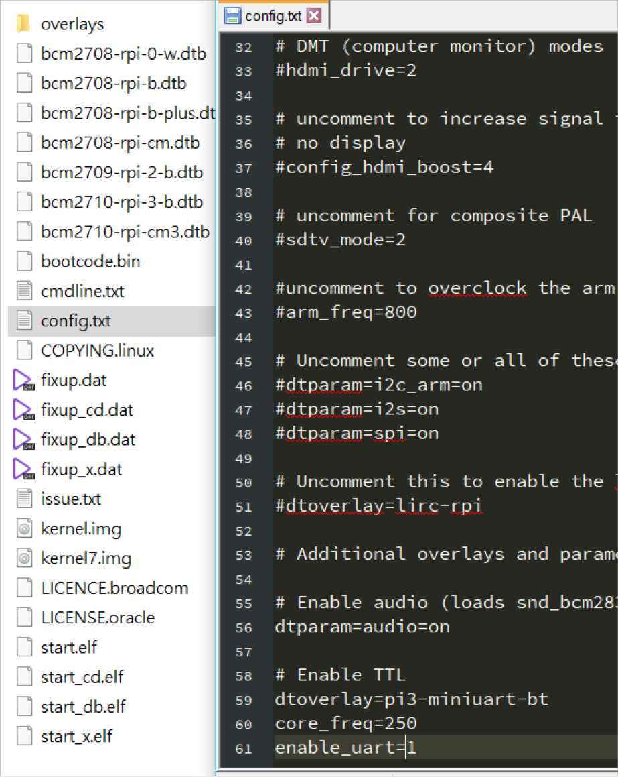
Enable UART
Step 1
Append the following lines to /boot/config.txt
dtoverlay=pi3-miniuart-bt core_freq=250 enable_uart=1

Slide 18
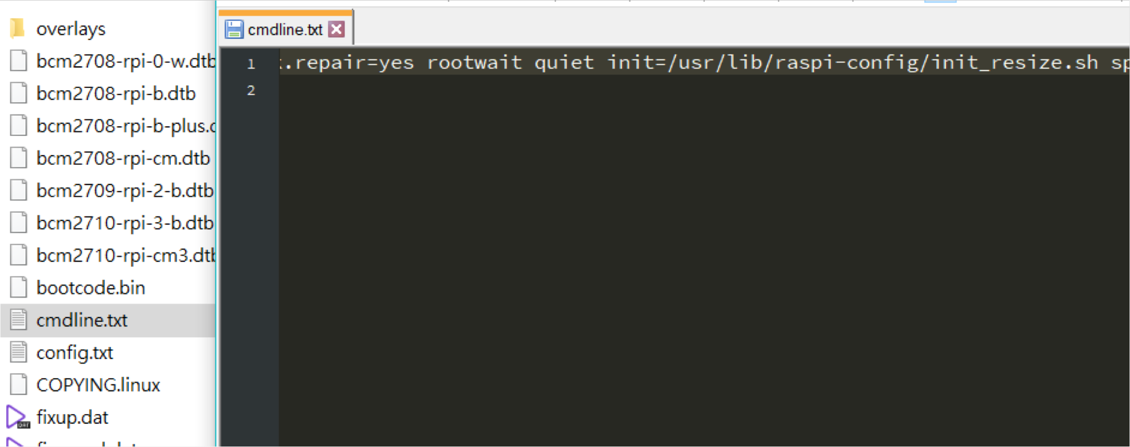
Enable UART
Step 2
Delete "quiet" in /boot/cmdline.txt
Remove it

Slide 19
Enable UART
After we have modified /boot/config.txt and
/boot/cmdline.txt in the SD card, we can eject the SD card from our computer and inject it into a Raspberry Pi.

Slide 20
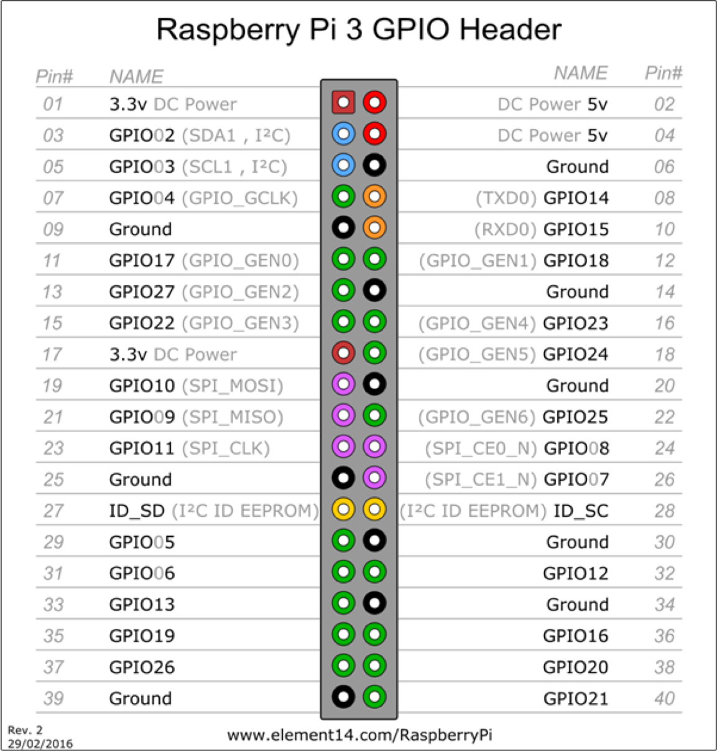
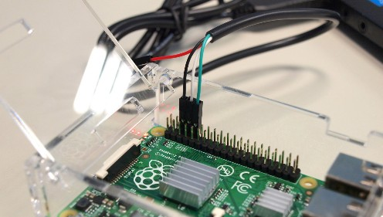
Enable UART
Step 3
Let Pi connect to TTL-to-USB cable as follows
Pin6: black line Pin8: white line Pin10: green line
20

Slide 21
Enable UART
Step 4
Download PL2303 drive and install it
Windows:
http://www.prolific.com.tw/US/ShowProduct.as px?p_id=225&pcid=41
If your OS is Windows10, you can forward to next step to check that whether your computer could find COM port or not.
Mac OS:
http://www.prolific.com.tw/US/ShowProduct.as px?p_id=229&pcid=41

Slide 22
Enable UART
Step 5
As PL2303 drive is installed, we should turn on Raspberry Pi and connect it to our computer by USB to TTL cable.
Then, checking that our computer could find the USB to TTL cable.
The different OS systems have different ways for checking, thus the following are for
Windows and Mac OS .
Click here for Mac OS

Slide 23
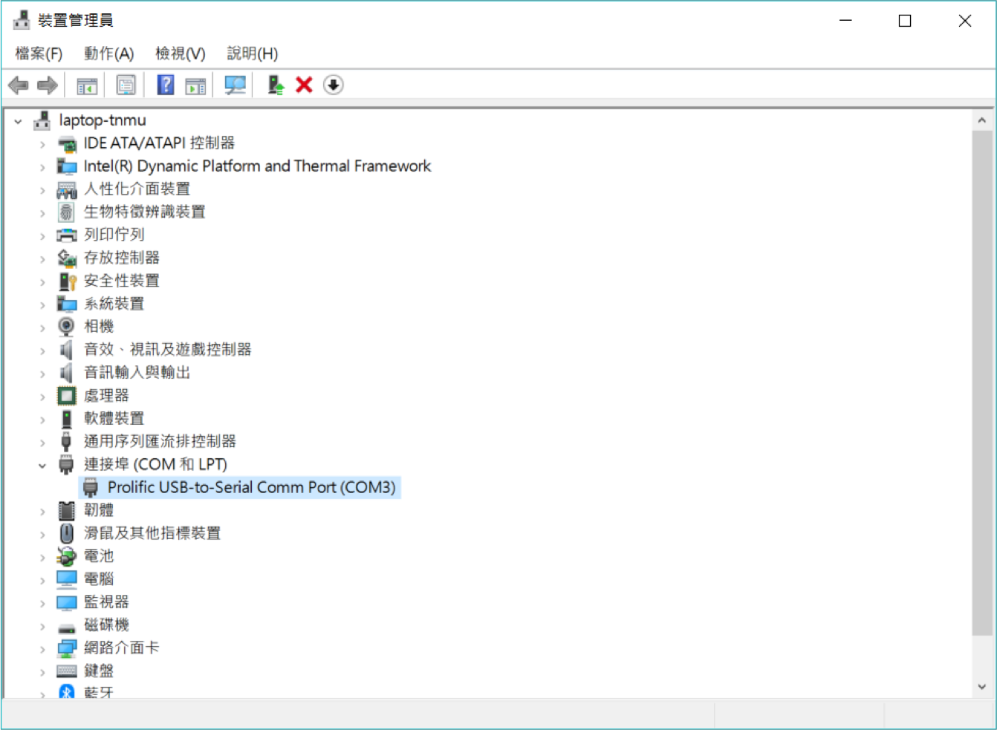
Enable UART
Step 6 (for Windows)
Open Device Manager and make sure that PORTs(COM & LPT) has USB-to-Serial Comm Port (COM x)
We will use that port to connect to Pi.

Slide 24

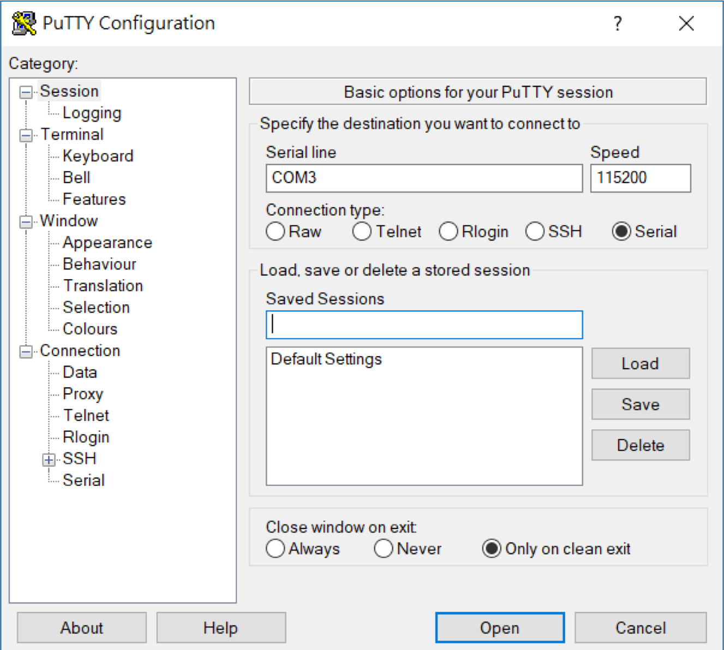



Enable UART
Step 7 (for Windows)
Then, open Putty
The number you see in USB-to-Serial Comm Port (COM x)
1
3
4
Set Speed as 115200
2
5
24

Slide 25
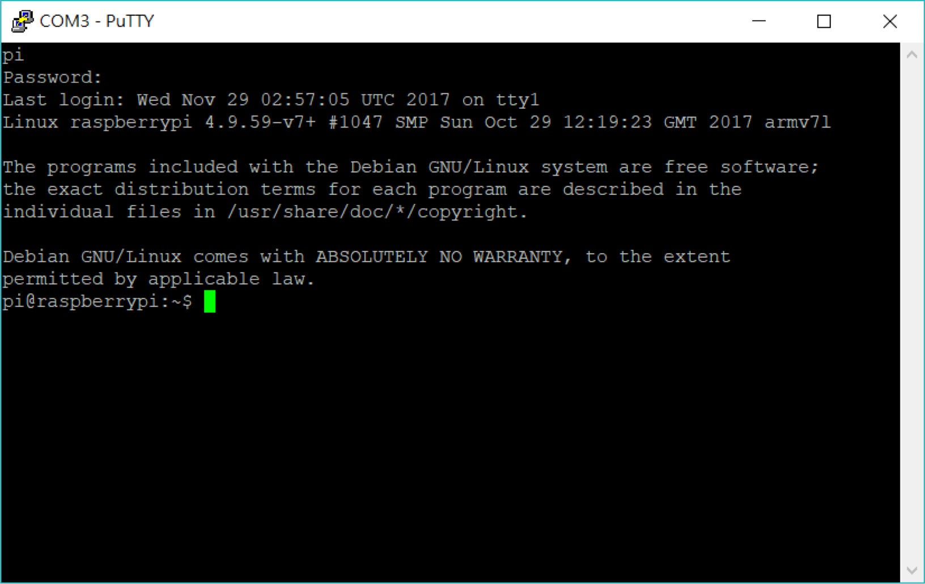
Enable UART
Step 8 (for Windows)
If we connect to Pi successfully, we could type username and password
Default setting username: pi password: raspberry

Slide 26
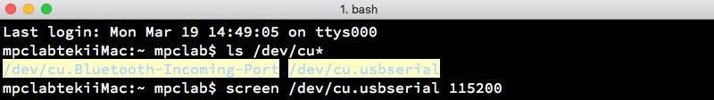
Enable UART
Step 6 (for Mac OS)
Open the terminal and type:
ls /dev/cu*
If /dev/cu.usbserial appears, we can connect to pi by screen
screen /dev/cu.usbserial 115200
Screen user's manual
https://www.gnu.org/software/screen/manual/ screen.html

Slide 27
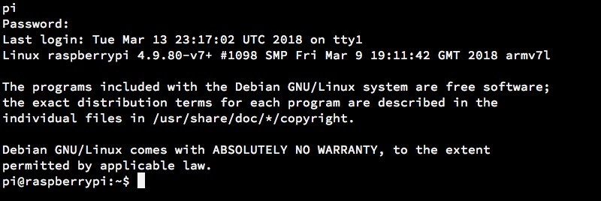
Enable UART
Step 6 (for Mac OS)
Default setting username: pi password: raspberry

Slide 28
Common commands in Linux terminal
Commands:
ls: list files in this directory
cd: change directory to other directory
e.g., cd home/pi/test
cd ..: change directory to the upper directory
cd ~: change directory to home/pi sudo shutdown: shutdown the system
e.g., sudo shutdown –h now : shutdown the system immediately
sudo reboot: restart the system
Useful tips:
Press "↑": show the last command Press "Tab": auto complete
28

Slide 29
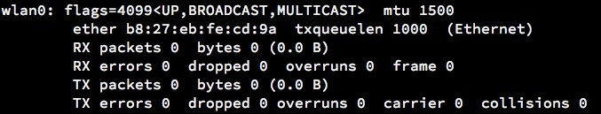
Configure network
After we connect to our Pi by UART, we can configure the network settings of Pi.
Now, let we configure the WiFi settings.
Before configure the WiFi, we should check our device has WiFi Interface wlan0, type:
ifconfig

Slide 30
Configure WiFi
We can configure WiFi by these 2 ways
raspi-config
Modify wpa-supplicant configuration file
The following introduces how to configure WiFi by raspi-config.
Type:
sudo raspi-config

Slide 31
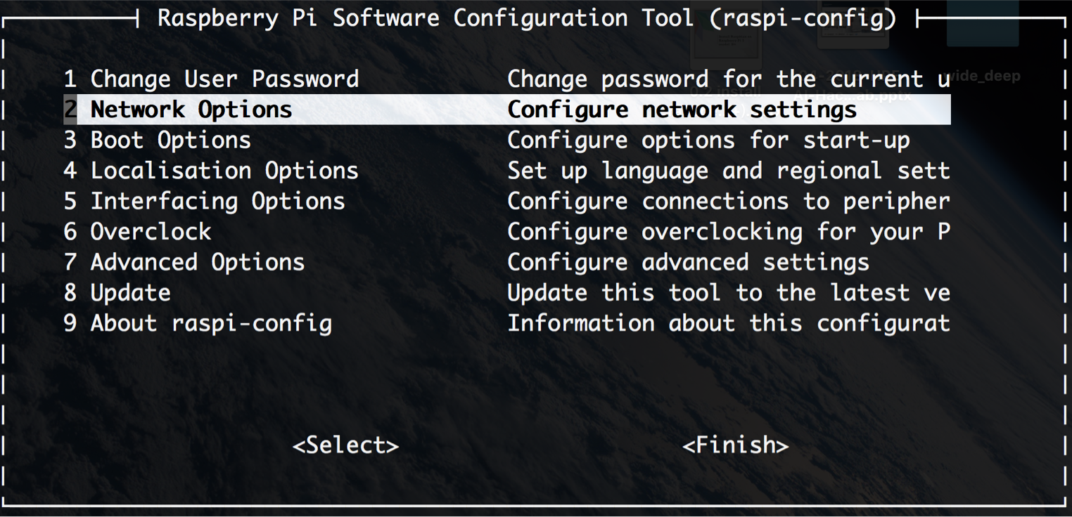
Configure WiFi
Step 1
Select 2 Network Options

Slide 32
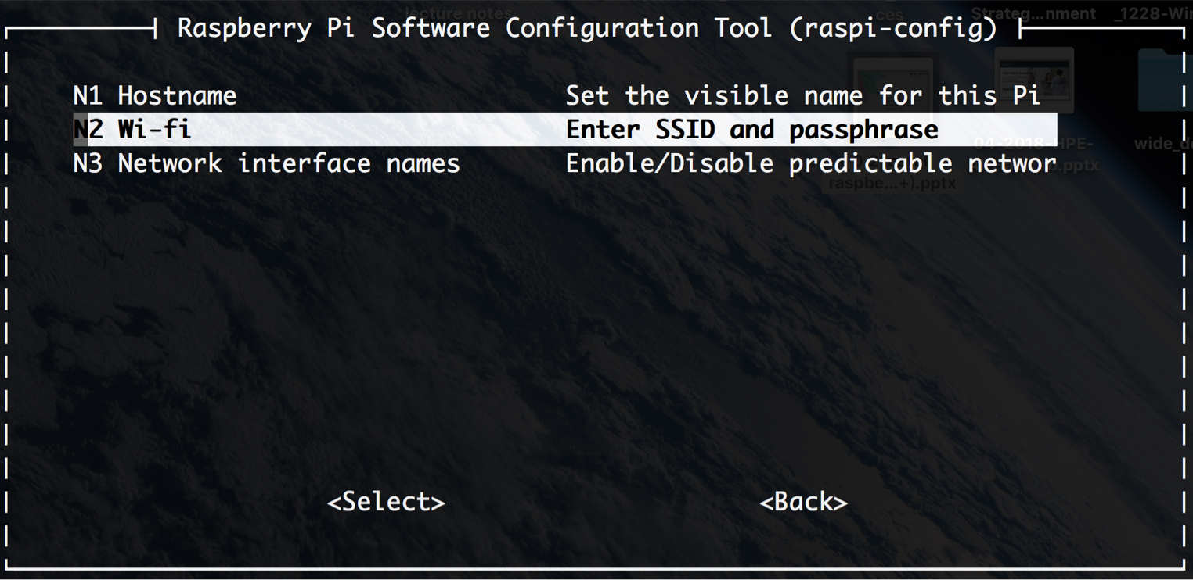
Configure WiFi
Step 2
Select N2 Wi-fi

Slide 33
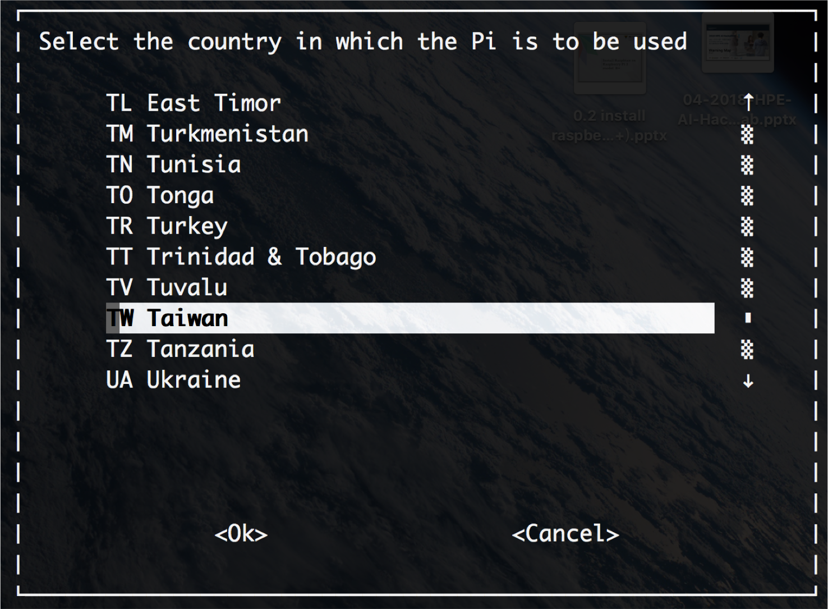
Configure WiFi
Step 3
Select the country

Slide 34
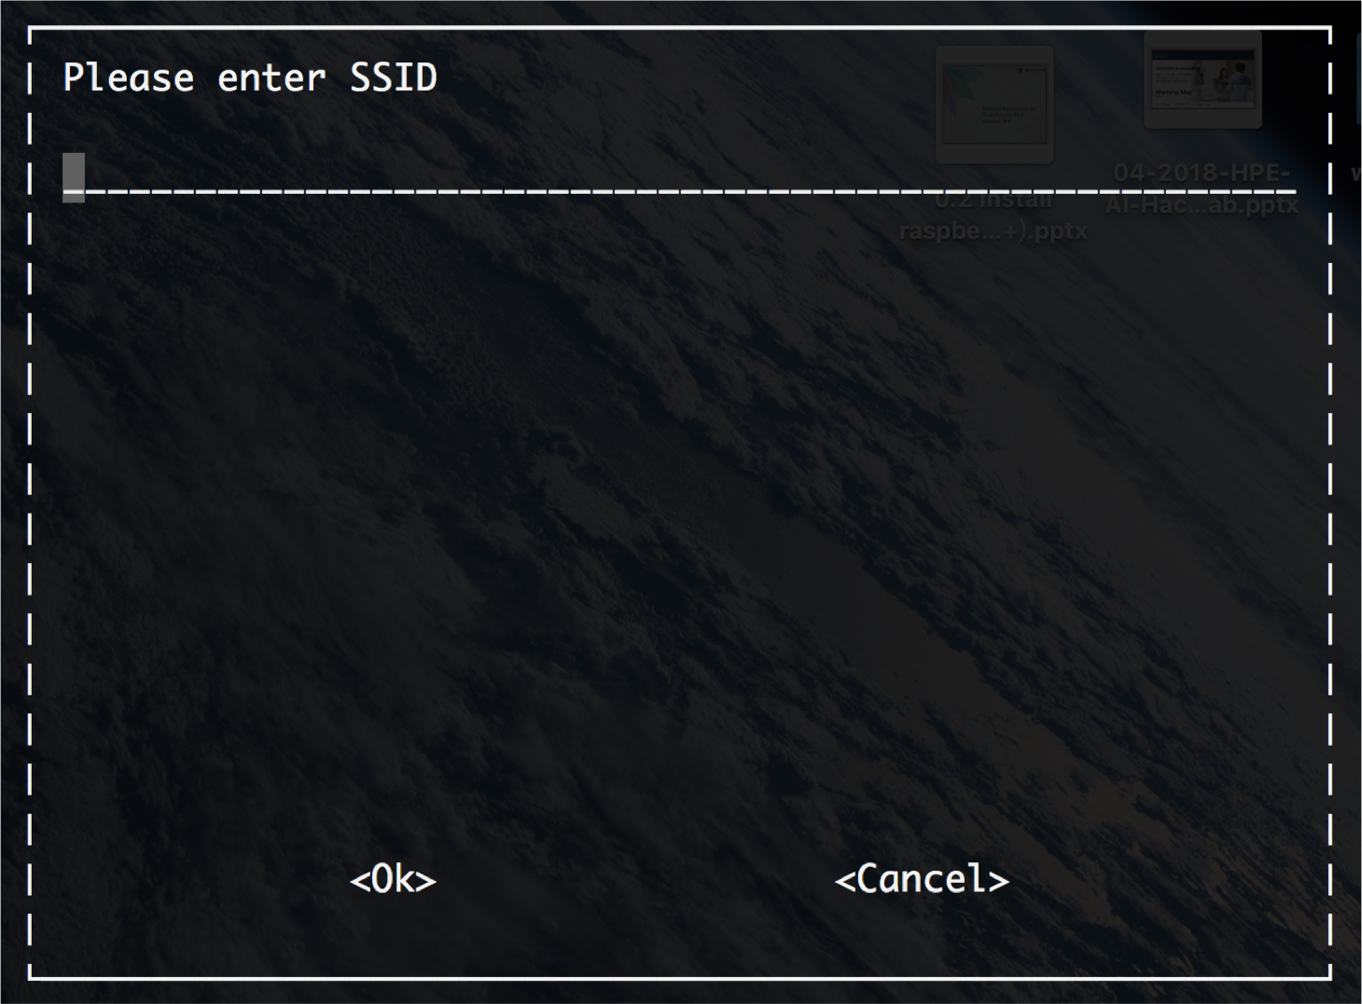
Configure WiFi
Step 4
Enter your WiFi AP's SSID

Slide 35
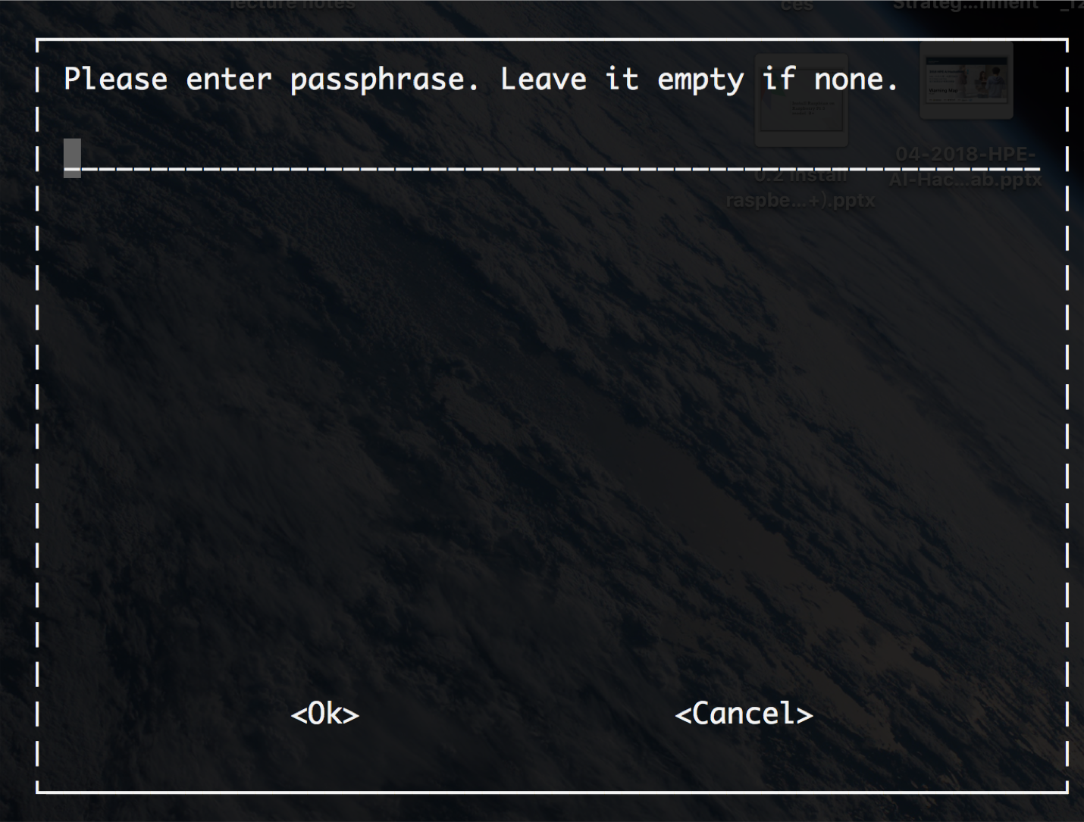
Configure WiFi
Step 5
Enter passphrase of that SSID

Slide 36
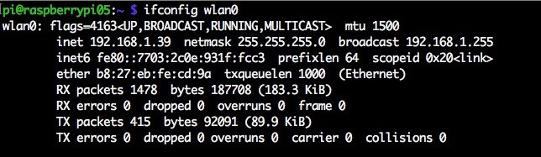
Configure WiFi
Step 6
Verify whether your Pi has successfully connected.
Type
ifconfig wlan0
If inet addr field has no address, check that your password and SSID are correct by looking
/etc/wpa_supplicant/wpa_supplicant.conf

Slide 37
Configure WiFi
Step 7
Type
sudo nano /etc/wpa_supplicant/wpa_supplicant.conf
Check the following two fields are correct. If not, modify them and reboot Pi
network={
ssid="SSID of AP" psk="password"
…
}

Slide 38
Connect to Pi
After we have set up the network of Raspberry Pi, we can connect that Pi by SSH or VNC without using TTL cable.
We recommend you using SSH.
Mac OS/Linux users use terminal and Windows users need install SSH client
SSH clients on Windows
Putty
OpenSSH (Win10 can enable it)

Slide 39
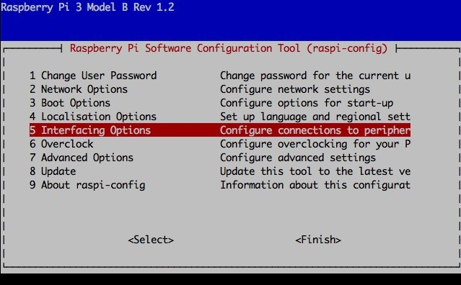
Connect to Pi (SSH)
Before using SSH to login Pi, we have to enable SSH of Pi first.
Type
sudo raspi-config

Slide 40
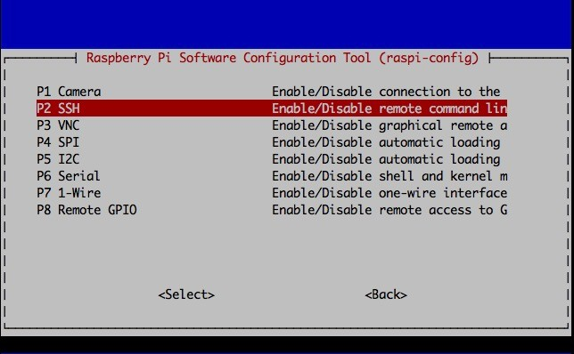
Connect to Pi (SSH)
Select p2 SSH

Slide 41
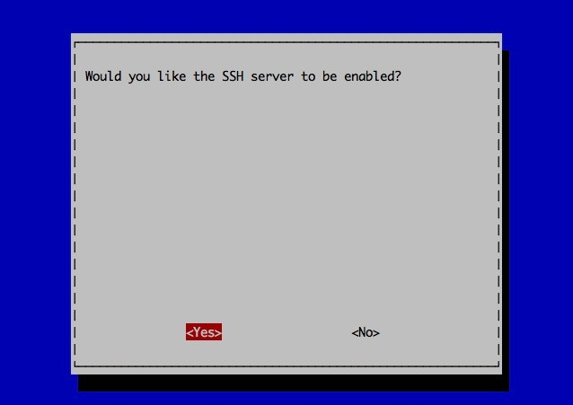
Connect to Pi (SSH)
Enable SSH

Slide 42
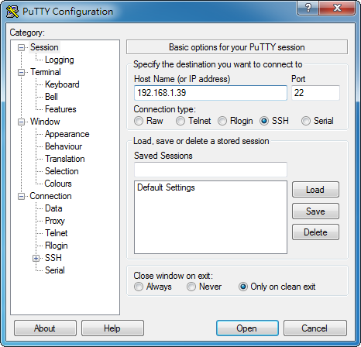
Connect to Pi (SSH)
Putty
Then, we open Putty to connect Pi by SSH.

Slide 43
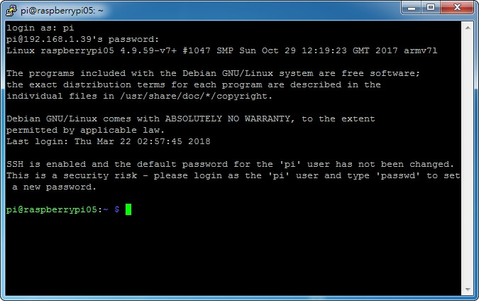
Connect to Pi (SSH)
Putty

Slide 44
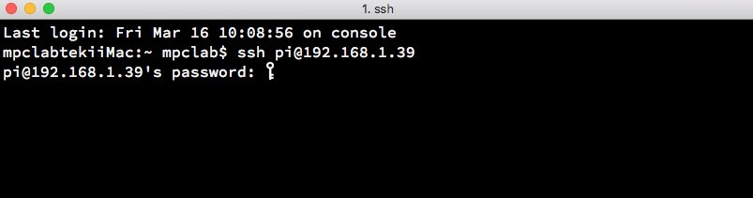
Connect to Pi (SSH)
Mac OS terminal
If we are using Unix-like system, just opening the terminal and typing:
ssh pi@"your_Pi_IP"

Slide 45
Copy file to Pi (SCP)
Usually, we write the code on our own computer and then transfer the source code file to Raspberry Pi.
To transfer files between a local host and a remote host, we can use Secure copy protocol(SCP).
SCP has installed in Unix system(command scp). If you have installed OpenSSH in Windows, you
can use scp command in CMD. Otherwise, you can use WinSCP.

Slide 46
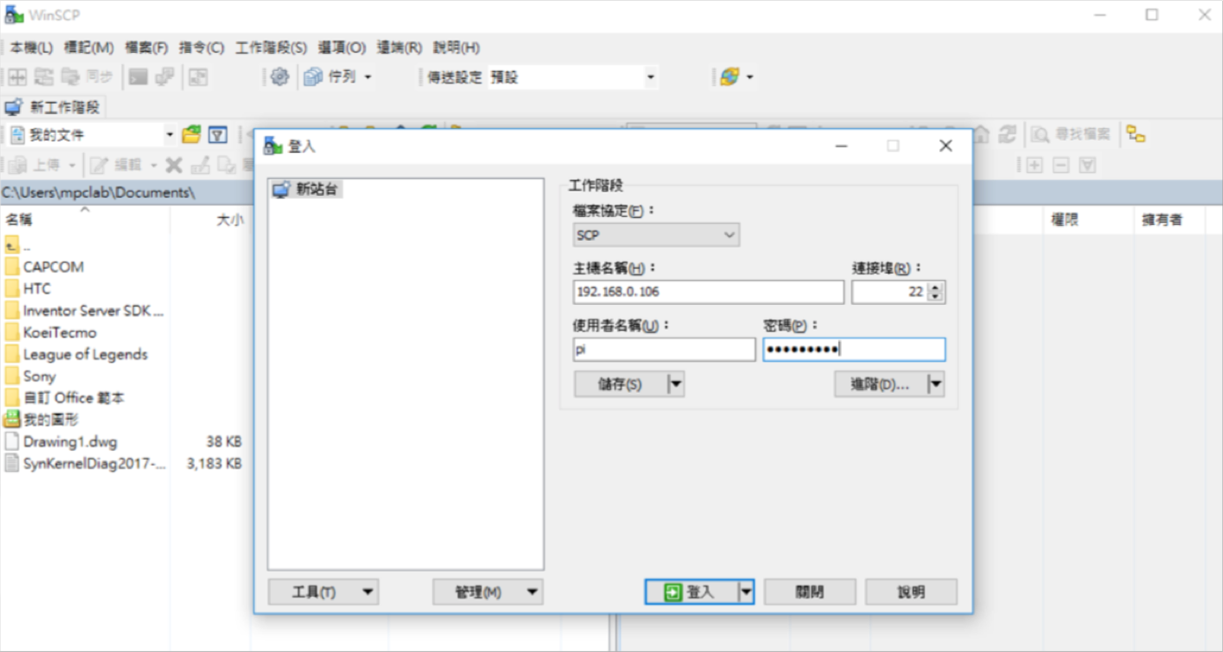
SCP
Windows
Download WinSCP
https://winscp.net/eng/download.php
Host name = IP address
User name = pi
Password = raspberry

Slide 47

FileZilla
Mac
Download FileZilla
https://filezilla-project.org
Host name = IP address
User name = pi
Password = raspberry
Port = 22
IP address
pi
raspberry
22

Slide 48
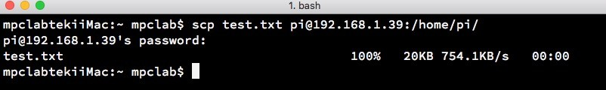
SCP
Linux / Mac OS
Open the terminal and type:
scp filename username@"your_Pi_IP":target_directory
Note that test.txt is in the current directory, you can copy the file in other directory by assigning the full filepath.

Slide 49
Python & Sensors

Slide 50
Outline
Python
Introduction
Rules
First Python programming
Sensors
Introduction
Digital sensors
Analog sensors

Slide 51
Python
Introduction
Interpreted high-level programming language
Compiled language
Source code
Interpreter
processing
Source code
Compiler
Machine
preprocessing
machine code

Slide 52
Python
Introduction
Dynamically language
No default types
a = 1 b = "Hello world"
Strongly typed language
Stricter typing rules at compile time
# String + Integer v = " result = " + 100 (wrong)

Slide 53
Python
Some rules
Python uses indentation to identify coding block.
EX: compare with java
We usually use 4 spaces as indentation.
Not to use Tab.
JAVA | Python
while (i <= 100) { s += i; i += 1; } | while i <= 100: s += i i += 1

Slide 54
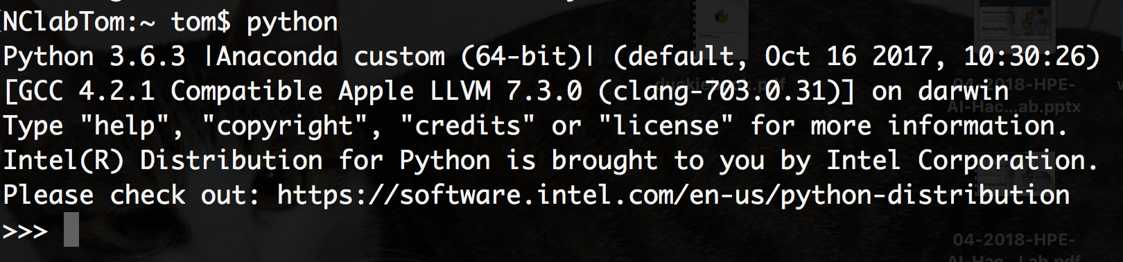

Python
How to run the first Python programming
In general, there are two ways to run Python.
Python shell (IDLE)
Python file

Slide 55
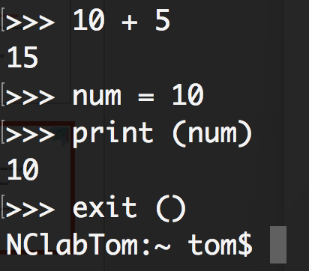
Python
How to run the first Python programming
Python shell (IDLE)

Slide 56
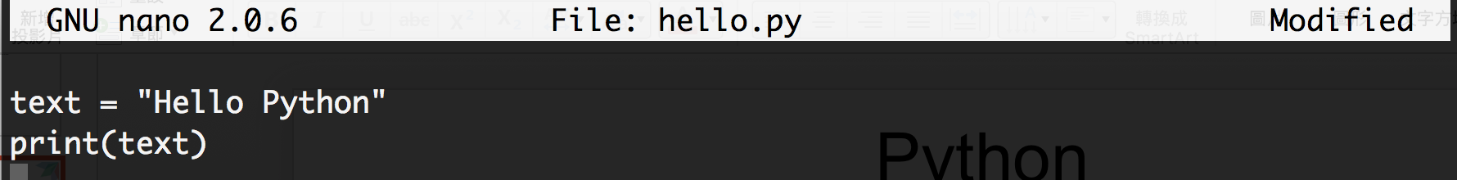
Python
How to run the first Python programming
Python file
Use terminal mode to write code!
Steps
nano hello.py (create a file hello.py)
Write code!
Ctrl+O (save the file), Ctrl+X (leave edit mode)

Slide 57
Python
How to run the first Python programming
if, if/else, if/elif/else
a = int(input("enter age => "))
if a < 13: print("children") elif a <20:
print("teenager") else: print("adults")

Slide 58
Python
How to run the first Python programming
for
for i in range(5): print("range(5) value =" + str(i))
while
m = int(input("calculate m!")
r=1
n=1
while n <= m:
r = r * n
n = n + 1
print("m!= " + str(r) )

Slide 59
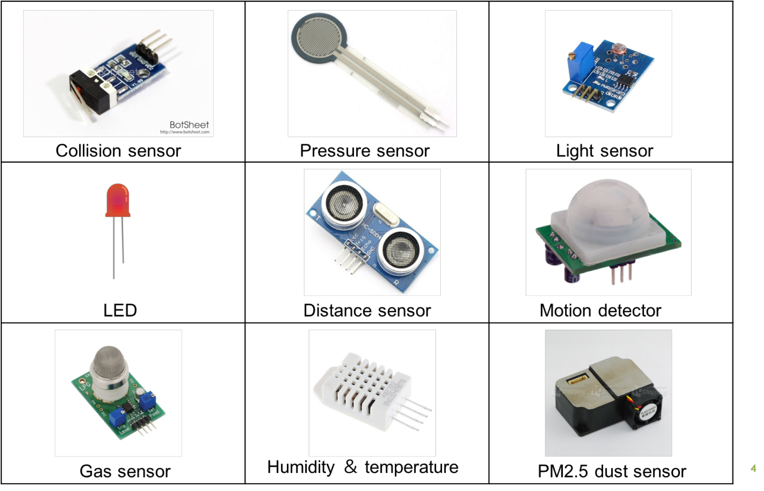
Introduction
Sensors
4

Slide 60
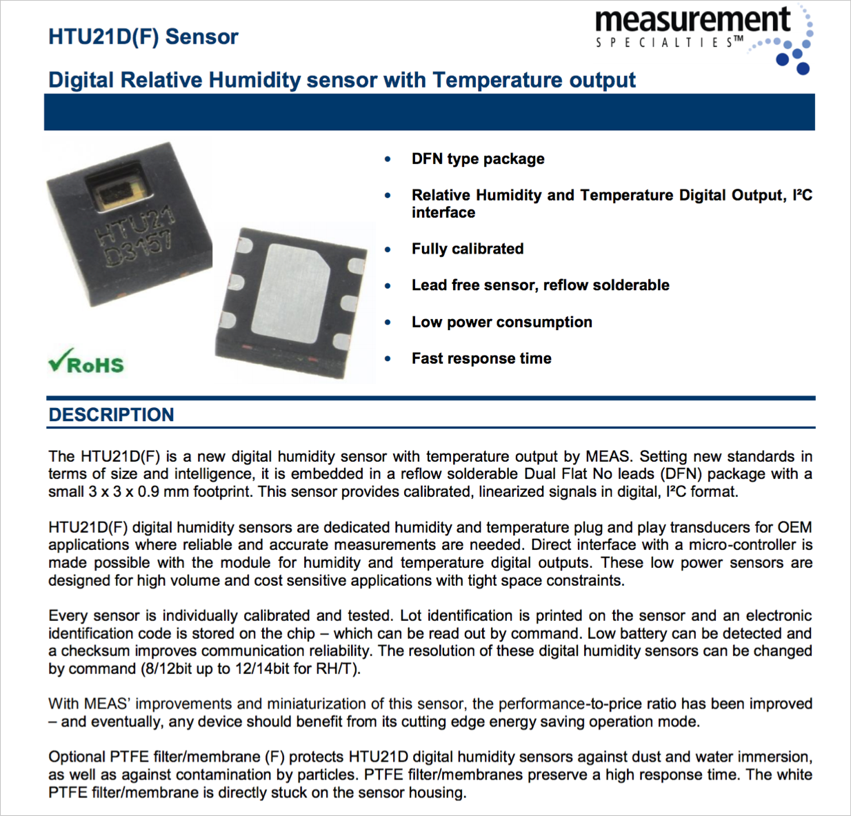
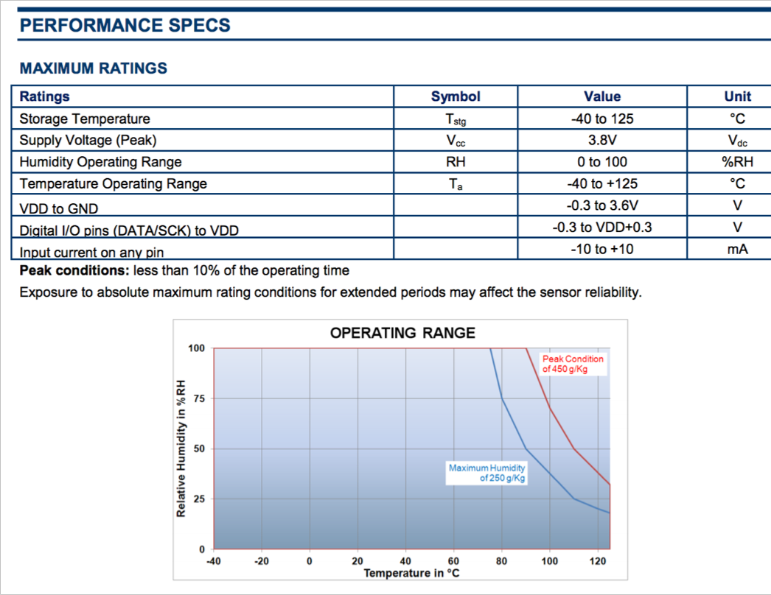
Introduction
Datasheet
https://cdn-shop.adafruit.com/datasheets/1899_HTU21D.pdf
5

Slide 61
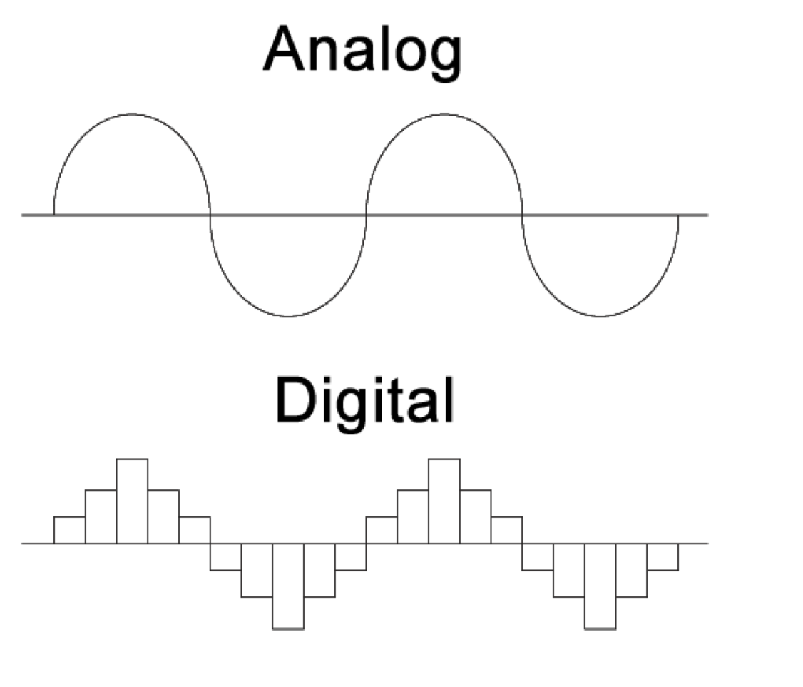
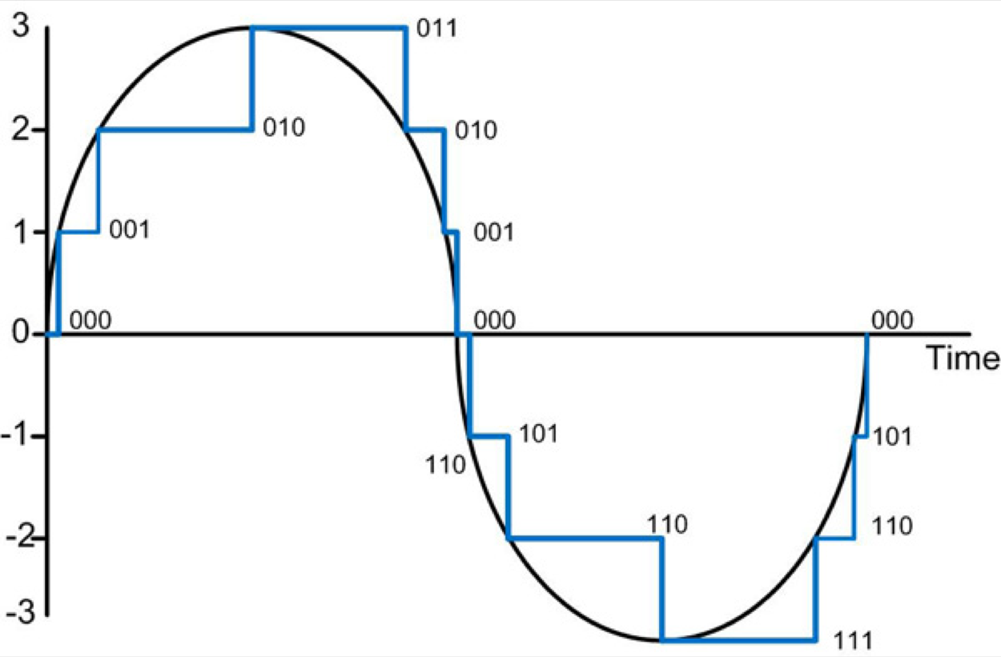
Introduction
Digital & Analog
http://www.droneuplift.com/is-ppm-analog-or-digital/
6

Slide 62
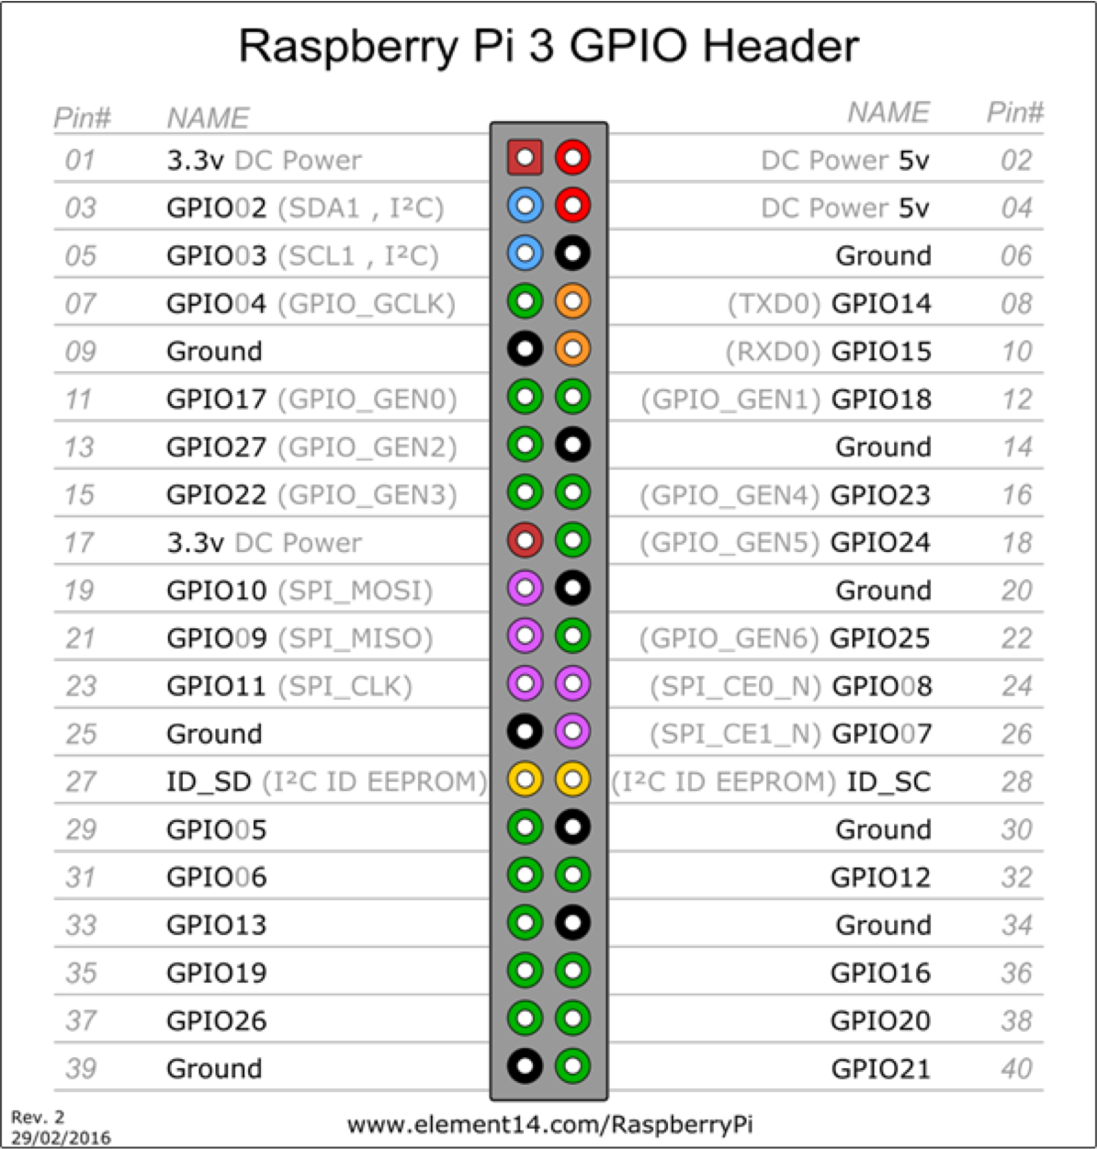
Introduction
GPIO
Board
Board
BCM
7

Slide 63
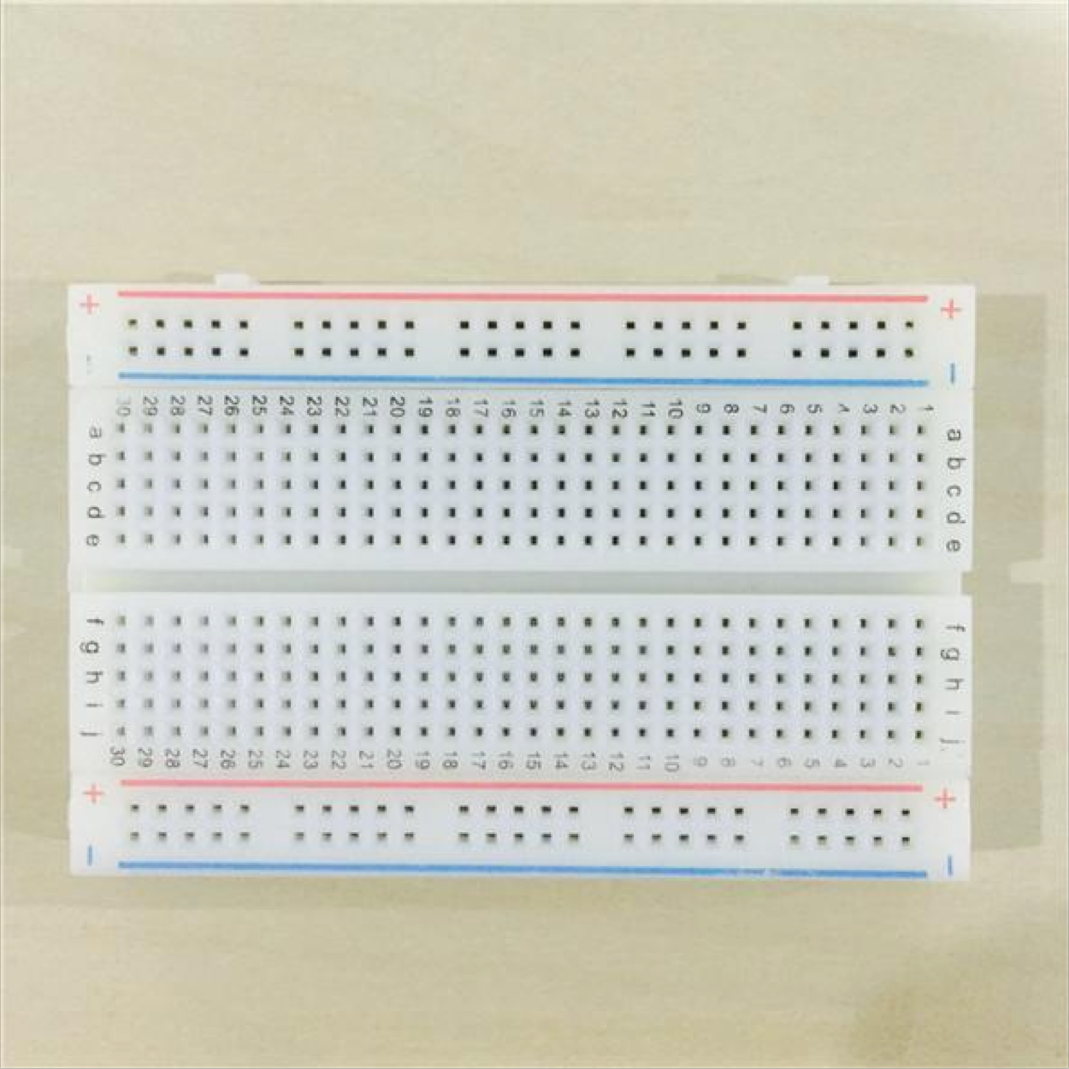
Introduction
Breadboard
8
https://kknews.cc/news/pqprzqj.html

Slide 64

Digital sensors
LED
Light-emitting diode (LED)
Features
Efficiency
Long lifetime
Cool light
…
Vcc
GND
10

Slide 65
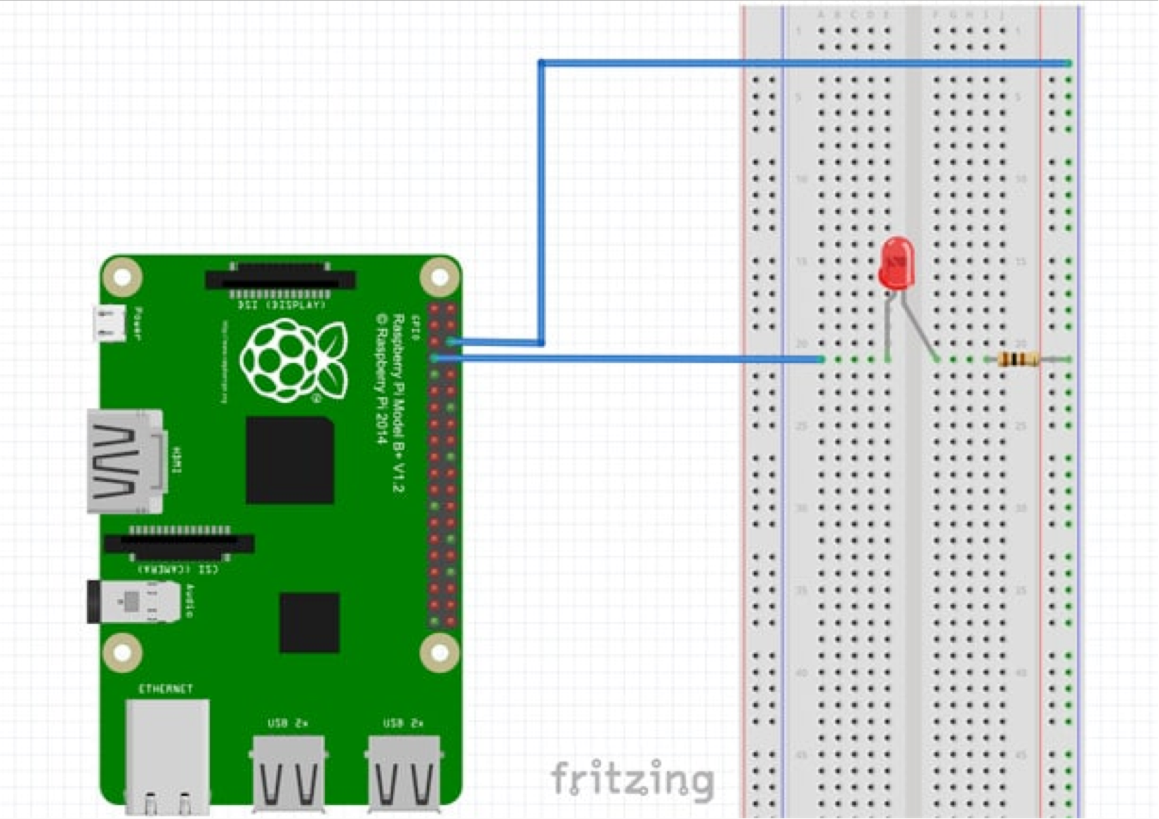
Digital sensors
LED
https://pimylifeup.com/raspberry-pi-gpio/
11

Slide 66
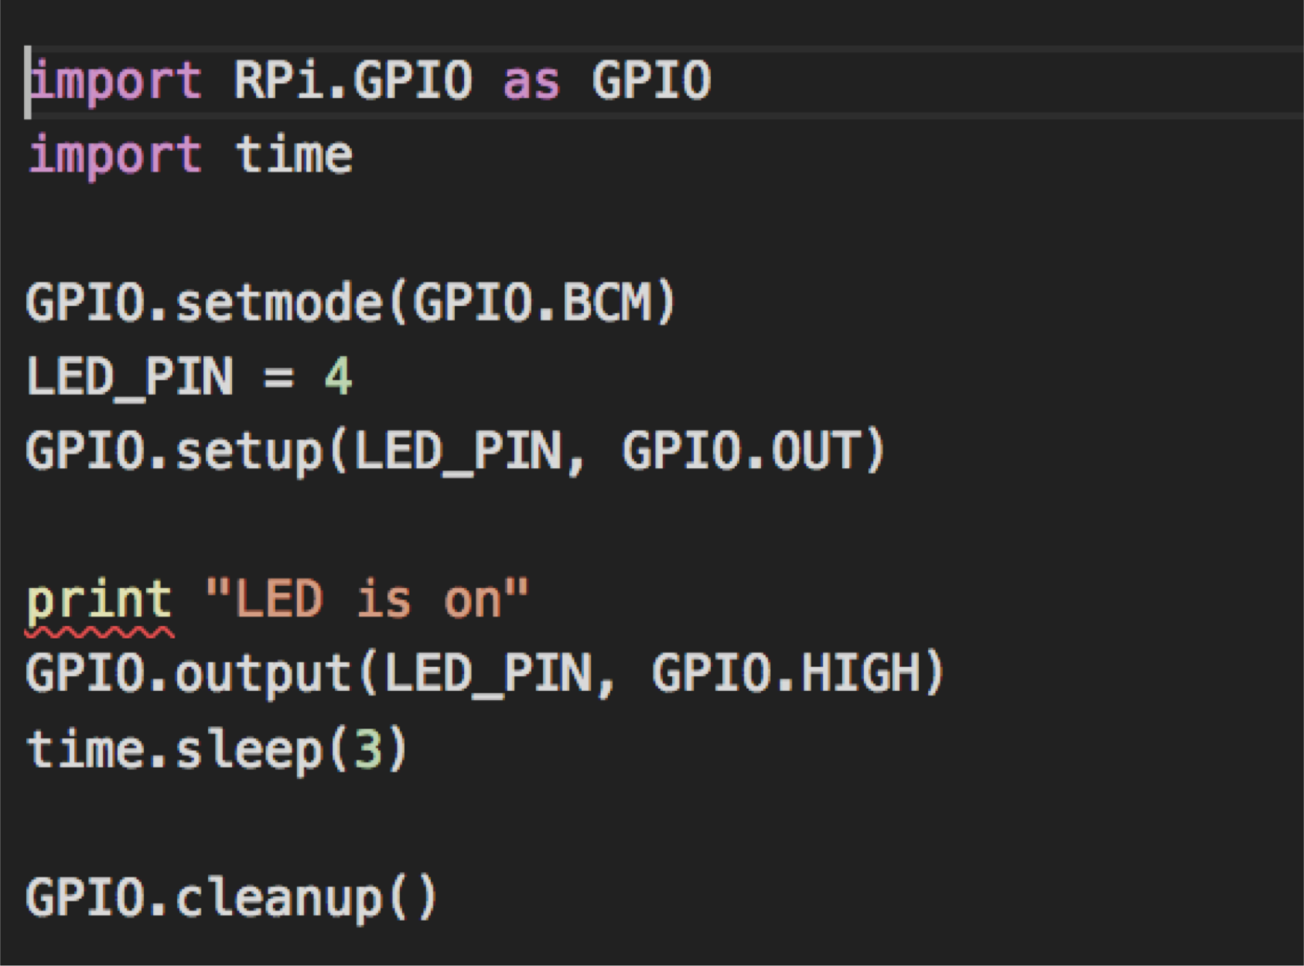
Digital sensors
LED_python
12

Slide 67
Digital sensors
LED_python
Where is the code?
Use editor (nano,vi,vim… ) write by yourself
Use SCP to transfer from your laptop
Run the sample code
python led_on.py
13

Slide 68


Digital sensors
LED_Node-RED
14

Slide 69

Digital sensors
LED advanced
https://social.technet.microsoft.com/wiki/contents/articles/34211.c-traffic-lights- simulation-via-leds-on-raspberry-pi.aspx
15

Slide 70

Digital sensors
LED advanced
python traffic_light.py
16

Slide 71


Digital sensors
Push button
http://www.ladyada.net/learn/arduino/lesson5.html
17

Slide 72

Digital sensors
Push button
https://www.sitepoint.com/powering-raspberry-pi-projects-with-php/
18

Slide 73

Digital sensors
Push button
python push_button_cont rol_led.py
19

Slide 74

Digital sensors
Tilt switch
http://www.learningaboutelectronics.com/Articles/Tilt-sensor-circuit.php
20

Slide 75

Digital sensors
Tilt switch
21
https://www.slideshare.net/raspberrypi-tw/gpio-gameconsolestarterkit

Slide 76

Digital sensors
Tilt switch
python tilt_switch.py
22

Slide 77



Digital sensors
Buzzer
Self drive buzzer
External drive buzzer
http://www.buzzer-speaker.com/faq/buzzer%20self-external.htm
23

Slide 78

Digital sensors
Buzzer
24
https://www.slideshare.net/raspberrypi-tw/gpio-gameconsolestarterkit

Slide 79

Digital sensors
Buzzer
python buzzer.py
25

Slide 80


Digital sensors
Piano buzzer
26
https://en.wikipedia.org/wiki/Piano_key_frequencies

Slide 81

Digital sensors
Piano buzzer
27
https://www.slideshare.net/raspberrypi-tw/gpio-gameconsolestarterkit

Slide 82

Digital sensors
Piano buzzer
28

Slide 83

Digital sensors
Piano buzzer
python piano_buzzer.py
29

Slide 84

Digital sensors
Pyroelectric InfraRed sensor (PIR)
30
https://www.slideshare.net/raspberrypi-tw/gpio-gameconsolestarterkit

Slide 85

Digital sensors
Pyroelectric InfraRed sensor (PIR)
31
https://learn.adafruit.com/pir-passive-infrared-proximity-motion-sensor/

Slide 86
Digital sensors
Pyroelectric InfraRed sensor (PIR)
Sensitivity range: up to 20 feet (6 meters) 110° x 70° detection range
Delay time range: 2.45s ~ 248s
Sensitivity range: 3m ~ 7m
Blockade time(Ti): 2.4s
https://www.slideshare.net/raspberrypi-tw/gpio-gameconsolestarterkit
32

Slide 87

Digital sensors
Pyroelectric InfraRed sensor (PIR)
33
https://learn.adafruit.com/pir-passive-infrared-proximity-motion-sensor/

Slide 88

Digital sensors
Pyroelectric InfraRed sensor (PIR)
python people_alarm_system.py
34

Slide 89

Digital sensors
Distance sensor (HC-SR04)
https://www.slideshare.net/raspberrypi-tw/gpio-gameconsolestarterkit
35

Slide 90



Digital sensors
Distance sensor (HC-SR04)
Speed vs. Distance
Resistance
https://www.slideshare.net/raspberrypi-tw/gpio-gameconsolestarterkit
36

Slide 91

Digital sensors
Distance sensor (HC-SR04)
https://www.slideshare.net/raspberrypi-tw/gpio-gameconsolestarterkit
37

Slide 92


Digital sensors
Distance sensor (HC-SR04)
python hc_sr04_measure_distance.py
38

Slide 93


Analog sensors
Photoresistor (light sensor)
Raspberry pi → GPIO inputs are purely digital
MCP3008
SPI protocol
10 bits
40

Slide 94

Analog sensors
Photoresistor (light sensor)
SPI
https://learn.sparkfun.com/tutorials/serial-peripheral-interface-spi
41

Slide 95


Analog sensors
Photoresistor (light sensor)
Turn on SPI
sudo raspi-config
42

Slide 96

Analog sensors
Photoresistor (light sensor)
Check SPI module
Install packages
sudo apt-get update
sudo apt-get install –y python-dev python-pip
sudo pip install spidev
43

Slide 97

Analog sensors
Photoresistor (light sensor)
https://www.slideshare.net/raspberrypi-tw/gpio-gameconsolestarterkit
44

Slide 98

Analog sensors
Photoresistor (light sensor)
python photoresistor.py
45

Slide 99

Analog sensors
Photoresistor (light sensor)
spi.xfer2()
Input (3 bytes)
Byte 1: the start bit (0x01)
Byte 2: configure bits
Byte 3: don’t care
https://www.slideshare.net/raspberrypi-tw/gpio-gameconsolestarterkit
46

